Slide 2

CARGO LOADING

Slide 3
Student’s Name | Roll Number | Branch
Revanth Sai Bomma | 1/23/SET/BCS/417 | CSE AIML
Akshita Chauhan | 1/23/SET/BCS/465 | CSE AIML
Bhumika Rawat | 1/23/SET/BCS/408 | CSE AIML
Utsav Kumar | 1/23/SET/BCS/427 | CSE AIML
Under the Guidance of
Ms. Deepika Kataria

Slide 4
CONTENTS
Introduction
Literature review
Proposed model
Proposed methodology
Results
Future scope
Conclusion

Slide 5
Introduction
The logistics industry often faces challenges in maximizing profit while staying within truck capacity limits.
Some goods (like rice, wheat, oil, sugar) can be divided into smaller portions, allowing partial loading.
This makes the Fractional Knapsack Algorithm an ideal choice, as it allows fractional selection of goods to achieve the highest profit possible.
The project implements this concept in Python and visualizes results using Matplotlib.

Slide 6
Literature review
Knapsack Problem:
A classical optimization problem used to select items to maximize value under weight constraints.
0/1 Knapsack: Items are indivisible; either taken fully or not at all.
Fractional Knapsack: Items are divisible; fractions can be taken based on profit-to-weight ratio.
Greedy Algorithm Principle:
Always pick the item (or part of it) with the highest profit per unit weight first.
Related Works:
Cormen et al. (2009): Introduction to Algorithms.
GeeksforGeeks (2024): Greedy Algorithms in Optimization.
Application of Knapsack models in logistics, inventory management, and finance.

Slide 7
Model
Algorithm Used – “Fractional Knapsack”
Algorithm Steps:
Compute Profit-to-Weight Ratio for each item.
Sort items in decreasing order of ratio.
Pick items until capacity is full:
  If the next item fits, take it fully.
  Else, take a fraction of it proportional to remaining capacity.
Compute Total Profit.
Why Greedy?
Greedy approach ensures optimality for fractional problems.
Simple, fast (O(n log n)), and efficient for real-world logistics applications.

Slide 8
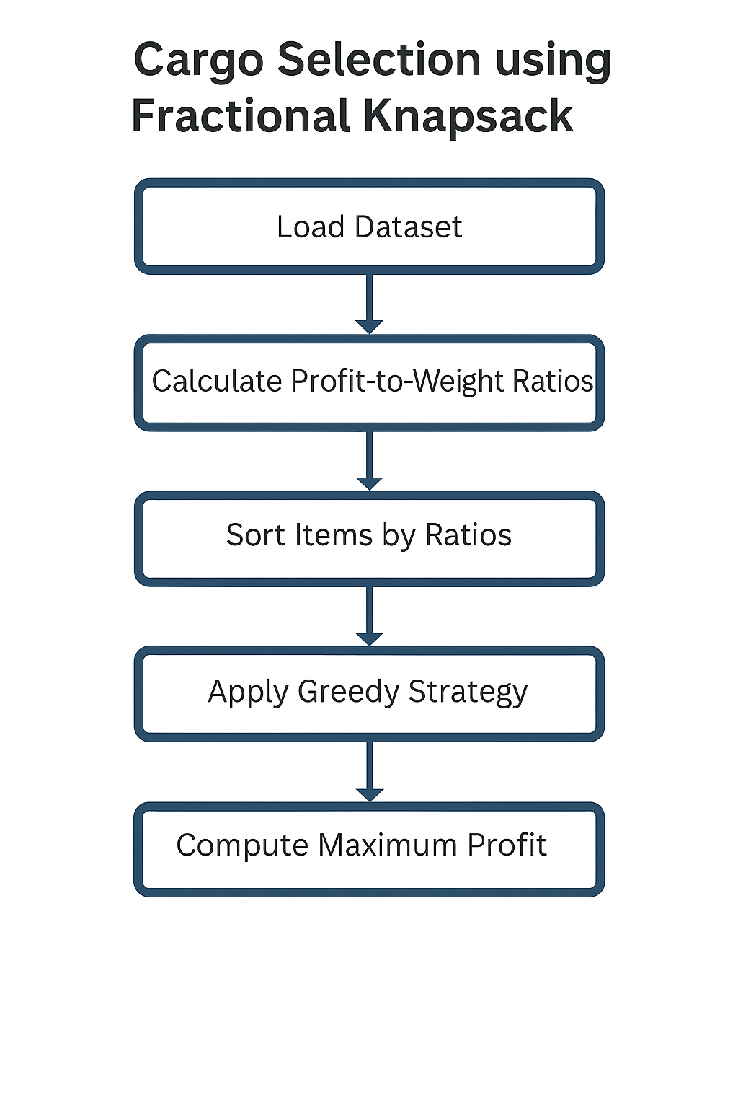
Methodology

Slide 9
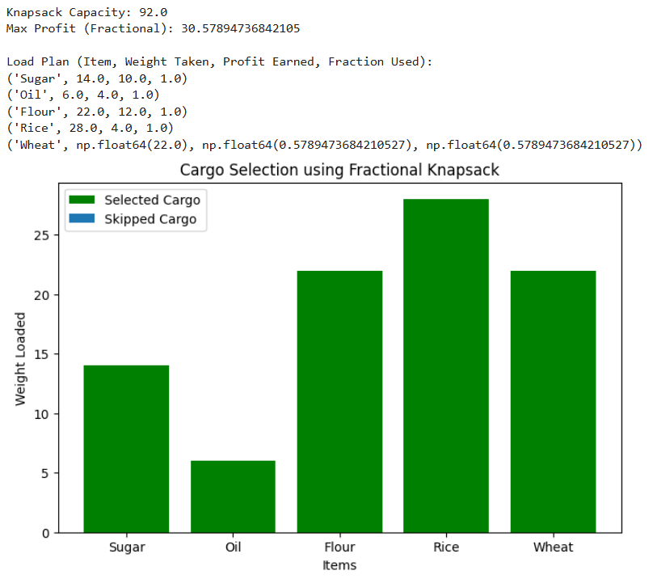
RESULTS

Slide 10
Future scope
Extend model for multi-truck optimization.
Integrate real-time logistics data from APIs.
Add machine learning to predict future profits.
Include multi-constraint knapsack (weight, volume, time).
Build a dashboard using Plotly or Power BI for deeper analysis.
Develop a mobile app for field-level cargo management.
Compare 0/1 and Fractional Knapsack in the same app.

Slide 11
Conclusion
The project successfully applies the Fractional Knapsack Algorithm to optimize cargo loading.
It maximizes profit while fully utilizing available capacity.
The Greedy approach ensures optimality with high efficiency.
The Streamlit web app provides an interactive and visual way to understand algorithmic optimization.
This model can serve as a foundation for real-world logistics and supply chain decision-making.

Slide 12
Thank You

